Slide 1
Google Analytics and R A Brief Primer Into Time Series Analysis
❤️

Slide 2
Summary
By the end of this presentation, you should be familiar with the following;
1) Google Analytics API
2) Simple Oauth2
3) Time series manipulation in R
4) Spotting trends in time series

Slide 3
First of All, Who Cares?

Slide 4
Why would you use Google Analytics?

Slide 5
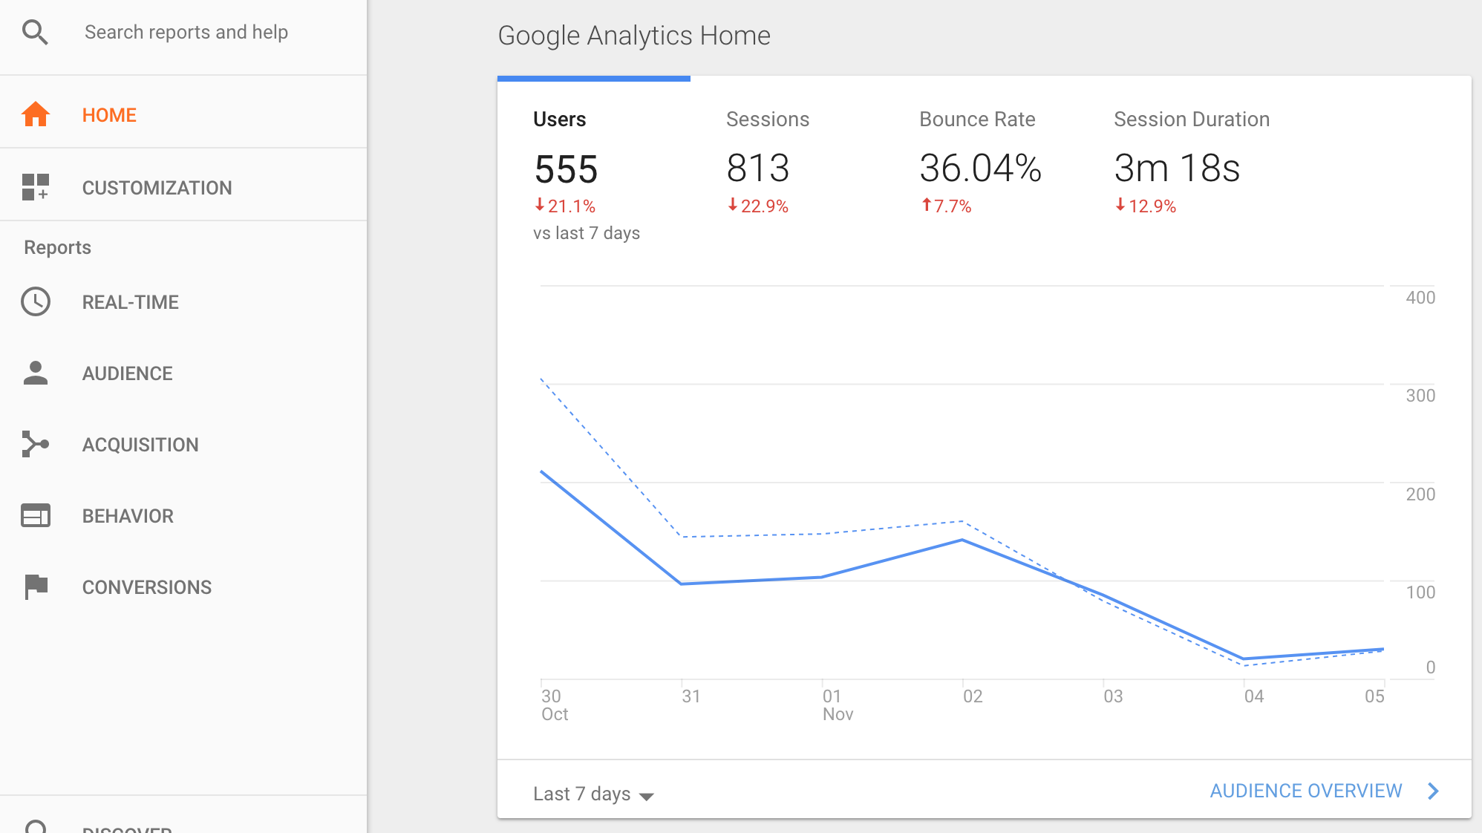
Google Analytics is Already Great!
You can already do almost everything you need to within GA itself
Segmenting
Filtering
See if your grandma in Finland is currently on your site
.xlsx export to a pivot table
PRO TIP: Do not complicate your report if you don’t need to!!!

Slide 6
Why Stream GA Data into RStudio?
1) Programmatically manipulate data
2) Reproducible/automated reports
3) More in depth analyses ➡️ ➡️ ➡️ such as time series analyses!
4) You are in control of your life (and your data)! Don’t let Google do everything for you!

Slide 7
Connecting Google Analytics to R
“How can I access my GA data with R? Don’t I need to log in with my browser? What is an API?”
Google Analytics Data
⁉️

Slide 8
What is Oauth2? A Protocol for Authorization
At it’s core, Oauth2 is a protocol that allows your R script (or client) to interact and retrieve data from another application which you have full user access to (Google Analytics)
Google
Accounts
Your R script
You
Google
Analytics

Slide 9
You only need the following to connect:
A Google account with access to a website’s Google Analytics
ClientID ➡️ you get this from Google API console
Client Secret ➡️ you get this from Google API console
Access Token ➡️ you get this from R using the ClientID and Secret

Slide 10
You know enough

Slide 11
Google Analytics Quick Setup
Navigate to Google Developers Console. (https://console.developers.google.com/project)
Create a New Project and Open it.
Navigate to APIs and ensure that the Analytics API is turned On for your project.
Navigate to Credentials and create a New Client ID.
Select Application Type – Installed Application.
Once your Client ID and Client Secret are created, copy them to your R Script.
We will go over an example of how to use the ClientID and Secret

Slide 12
Let’s Jump In

Slide 13
Case Question: Website Users Over Time
You work for a company called VidDevil, which is pretty much VidAngel except it filters out the good parts.
Your boss swings by your desk and asks “I want to know if our users have any particular watching habits, oh, and also if we are increasing in viewership year over year”

Slide 14
Strategy:
Objective:
Discover any patterns in how users use the website over time
Discover any underlying trends in user visits
Demonstrate an understanding of user growth on the site
Use R to pull in Google Analytics data of the VidDevil website
Analyze the time series data of visits to the site
Compare website visits year over year

Slide 15
📈 Let’s Get Coding! 📉

Slide 16
Overview: Time Series Data
A time series is any series of data points indexed in time order.
Time on the X-axis and any measurement you want on the Y-axis
Consecutive observations should be equally spaced, but don’t always need to be
Time indices should be discrete
Examples:
Temperature measured each day
Stock price per week
Ice thickness per year
Online purchases each month

Slide 17
Why Use a ts() Object?
Dates are a pain; it’s easier to deal with time indices ⏱
Plotting is easier 📈
Model estimation and forecasting is easier 🔮📆

Slide 18
What Story Does Your Time Series Tell You?
If it doesn’t tell a story, don’t show it!
If it fails the story audit, don’t even plot it

Slide 19
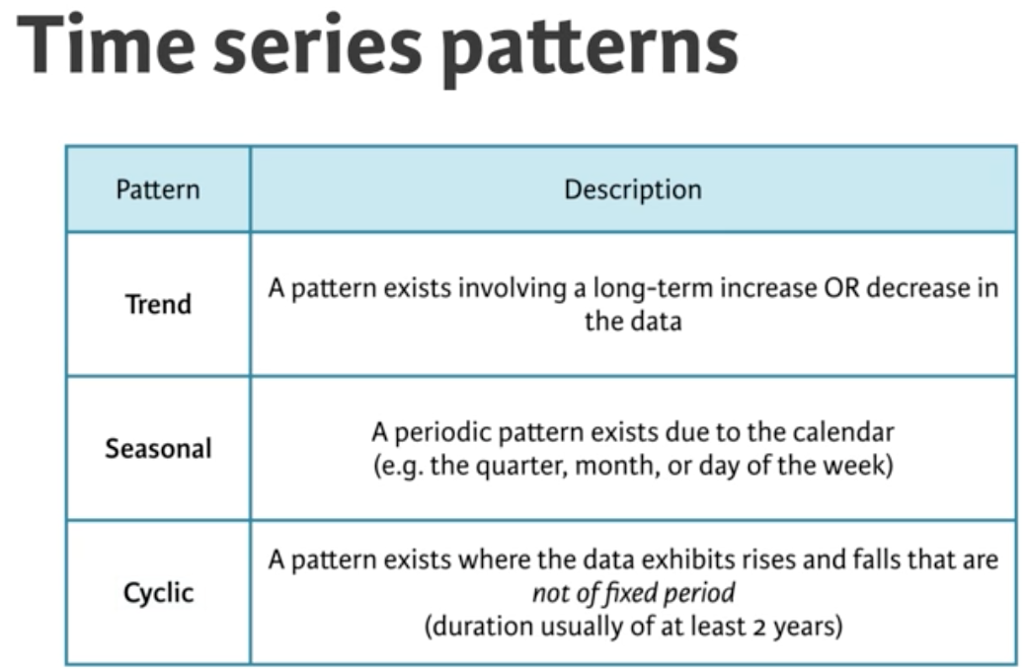
Spotting Patterns in Time
3 types of patterns to look for

Slide 20
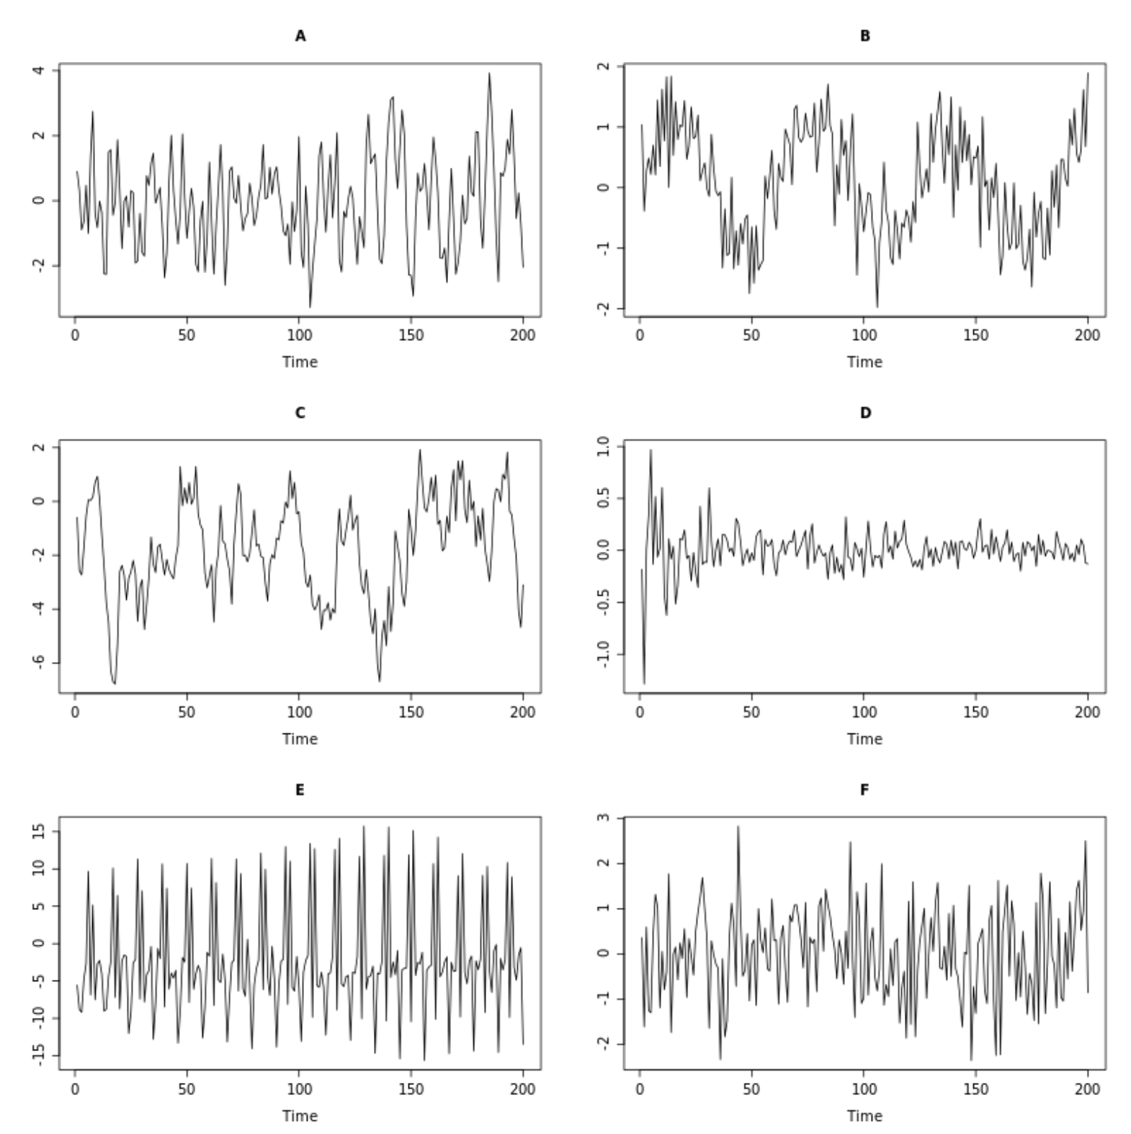
Spot the Pattern!
Remember:
Cyclic
Seasonal
Trend
Random

Slide 21
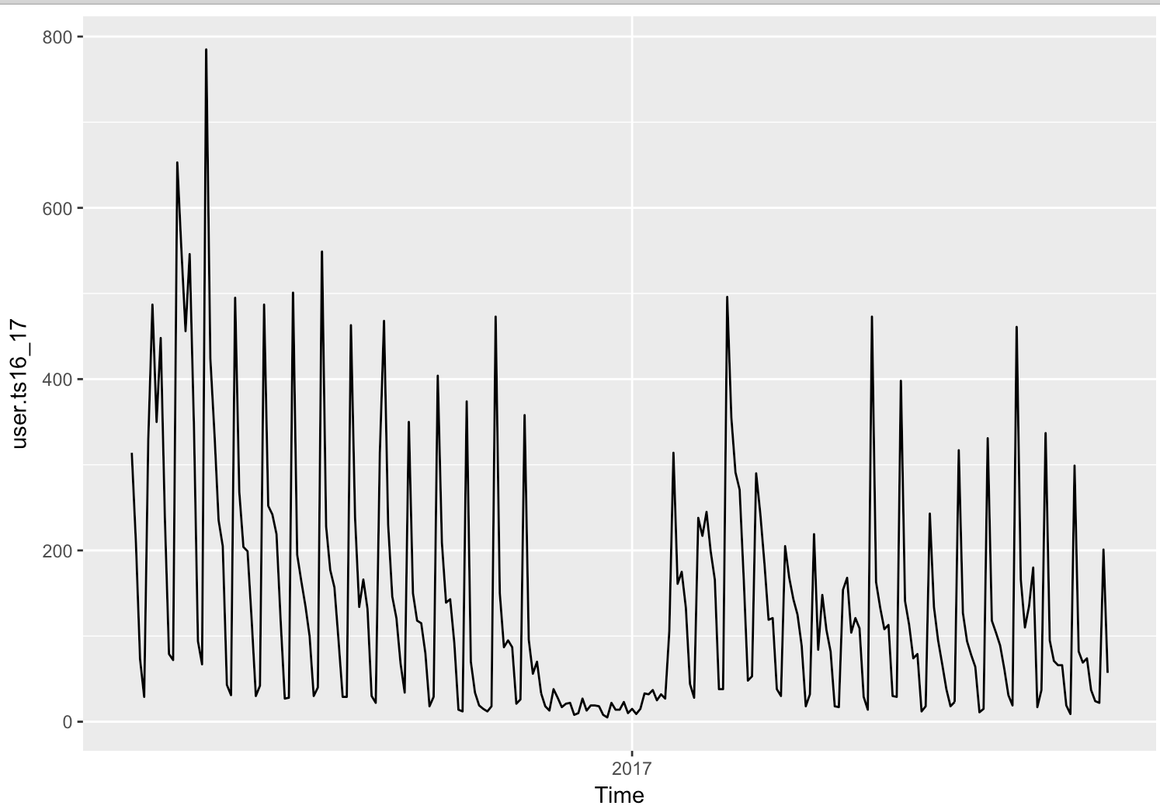
How Do You Check for Patterns?
Lets look at VidDevil user data for a business year:
Remember:
Cyclic
Seasonal
Trend
Random
Site Users
Time Index

Slide 22
ACF: Auto Correlation Function
An ACF is used to visualize correlations between time series values and values in the same series with a time lags
Time Lag
If your data is weekly, then any given week can be represented as
A data point for a given time could then be represented as
An ACF visualizes correlations between each data point and each possible time lag
t
y_{t}
Cor(y_{t,} y_{t-1,} y_{t-2} … y_{t-n})

Slide 23
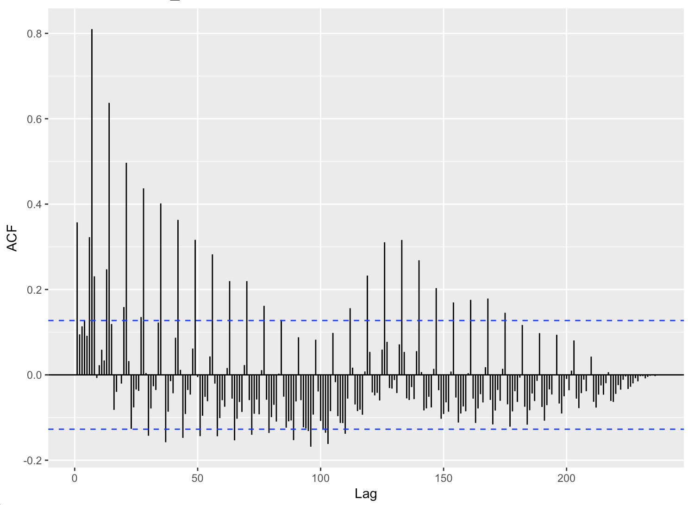
ACF for VidDevil Users
y₇
Story:
Seasonal Trend!
VidDevil Users love streaming our service every Monday.
Cyclical Trend!
VidDevil Users tend to come back ~130 days after the initial Fall release. Probably to return to watching filth after the Christmas season is over.
Correlations peak every 7 days
And after ~130 days
y₇
y₀

Slide 24

How Do We Sell The Story?
“My analysis demonstrates the following patterns:
First, a weekly pattern of use that peaks every
Monday, and second, a cyclical pattern that shows an
Increase in use every 130 days”
Your boss will vomit if he hears the term
”Auto Correlation Function”

Slide 25
Summary!
If you need to do more in-depth analysis of Google Analytics data, then access the data through the API
A time series should always convey something actionable
If your plot has no story, don’t even show it
Always simplify your story

Slide 26
Questions?

